Slide 1
Monmouth Mini Missions Lent 2021

Slide 2
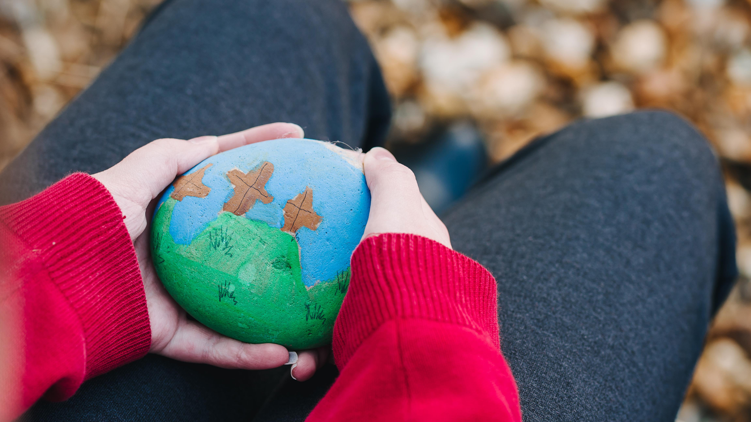
Everything you need is on our website
Resources - Monmouth Diocese (churchinwales.org.uk)

Slide 3
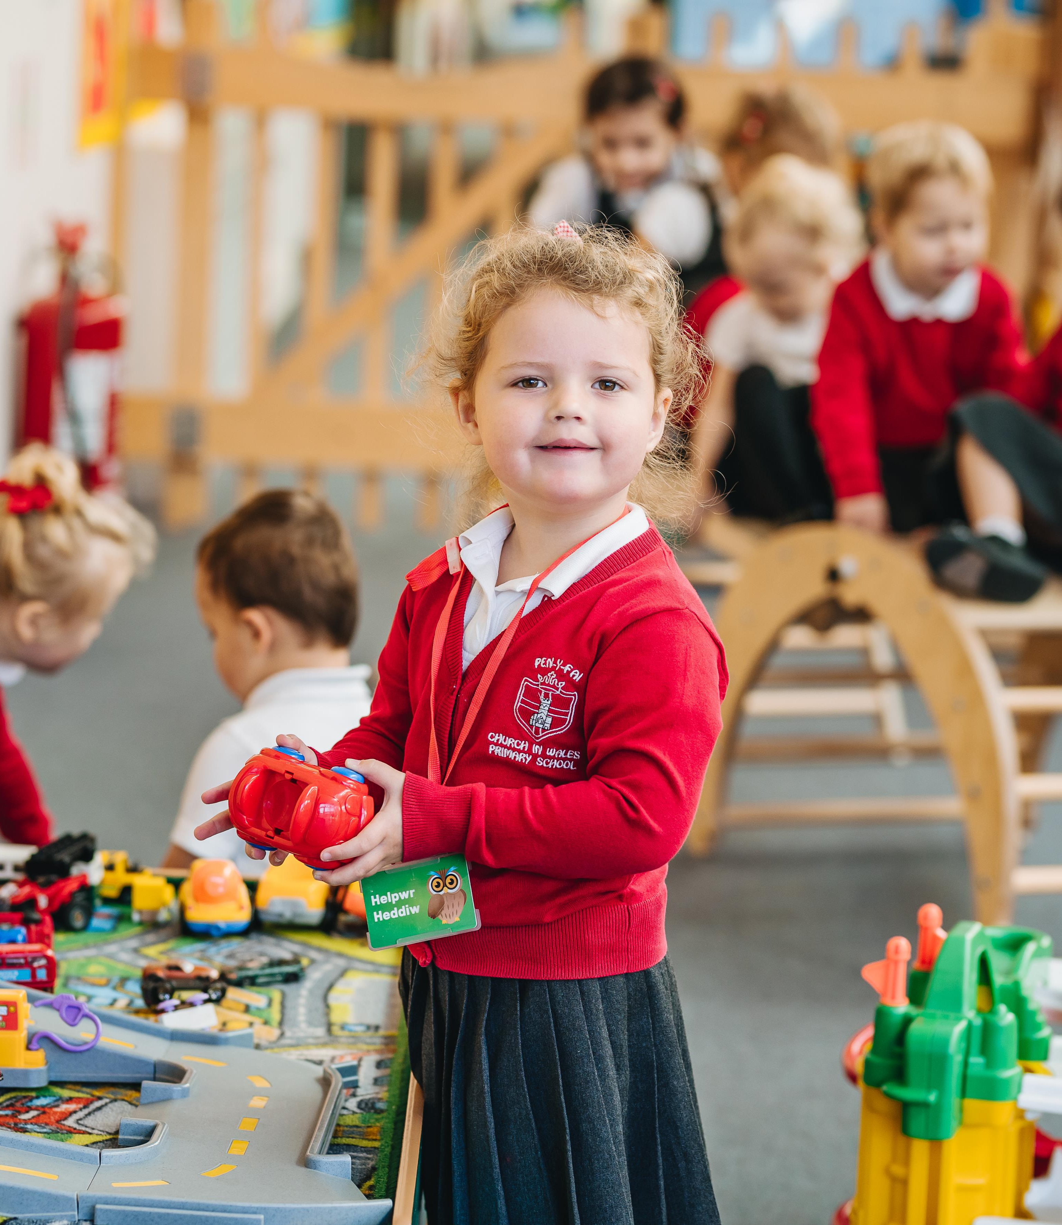
Five Ways to Wellbeing - NHS
1
Connect with other people
2
Be physically active
3
Learn new skills
4
Give to others
5
Pay attention to the present moment
Take Notice – Thank God
Keep Learning – from the Bible

Slide 4
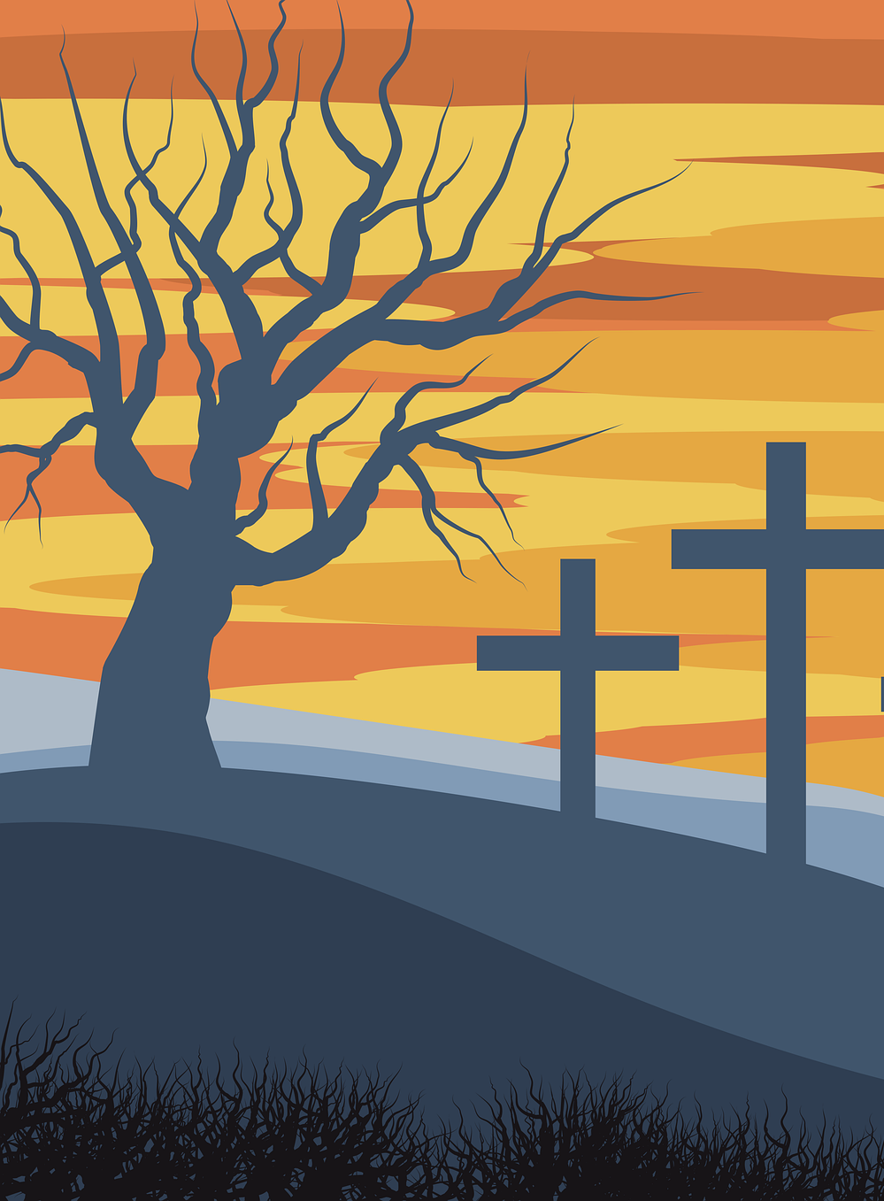
21 Day Lent Challenge – Mini Missions
School based learning or Home based learning
Introduction Video – Reverend Becca
Teacher Notes
Mini Journal
Overview of Mini Missions
Chart
Weekly Videos – Steve Lock

Slide 5
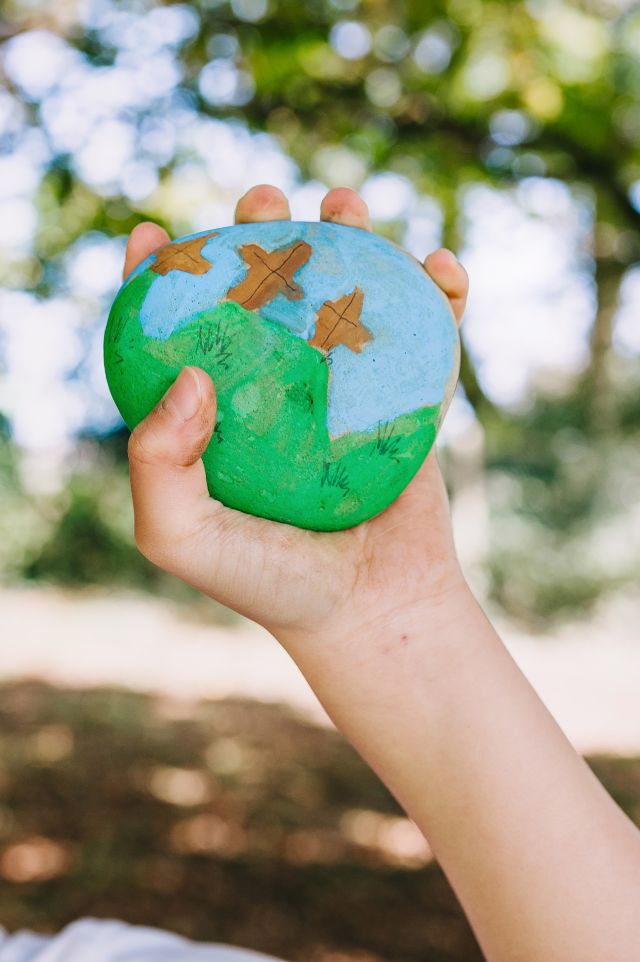
Mini Missions Grid
1 Join in - Watch Reverend Becca’s video on our website Monmouth Diocese (churchinwales.org.uk) introducing the 21-day challenge.
Connect | Be Active | Take Notice - Thank God | Keep Learning - From the Bible | Give
2 - Connect with your friends. Find out a fun fact about one of your friends. Can you connect with someone you haven’t spoken to for a while? | 3 - Be Active online PE with Jo, Cosmic Kids Yoga, Just Dance, Supermovers Take your pick! | 4 – Be Grateful Use the journal to write down 5 thing you are grateful for. You might like to use this to say a thank you prayer to your God. | 5 – Keep learning about Lent Spiritual Fitness Challenge Video 3 – Giving Something Up “Sacrifice” | 6 - Give Positivity. Give positive comments to someone to fill their bucket. Use the template in your journal.
7 – Connect with your church - Find your local church on google maps. Explore their website. Churches may like to send home information to schools regarding services for Easter. | 8 – Be active and walk Draw a map from your house to your local church or place of worship. Can you lead the way on a walk there? | 9 – Be Reflective Use your journal to write a memory about your local church or place of worship. Maybe a school service, a baptism or a wedding you have attended. | 10 –Keep Learning about Serving and Caring Spiritual Fitness challenge Video 4 – Taking something on “Service” | 11 – Give thanks Say/write a special thank you to three people that have helped you this week. You may also like to thank someone through prayer.
12 – Connect with another school. Write down the top 5 things about your school. Ask your teacher to share these with a class in another school. | 13 - Be Active online 2 PE with Jo, Cosmic Kids yoga, Just Dance, Supermovers Choose something different today. | 14 – Take Notice Step outside and think about the beauty of God’s world. Take a photograph of something that you think is beautiful to add to your journal. Diocese Photo competition | 15 – Keep Learning about Palm Sunday. Spiritual Fitness challenge Video 5 – On the Road | 16 – Give to others Make a donation to your local foodbank.
17 - Connect with your community. Write a positive message poster or draw a beautiful image to put in your window to cheer up everyone who walks past. | 18 – Be Active and Walk 2 Think about a wonderful walk in your local area. Share the route with your friends, class or school community. | 19 – Make a change Think about what you have learnt during your mini missions. What changes might you make and why? | 20 – Keep Learning about Easter Spiritual Fitness challenge Video 6 – Easter | 21 – Give to yourself Use the template in the journal to write 5 things that are great about you.

Slide 6
Resources

Slide 7
Lent Journal

Slide 8
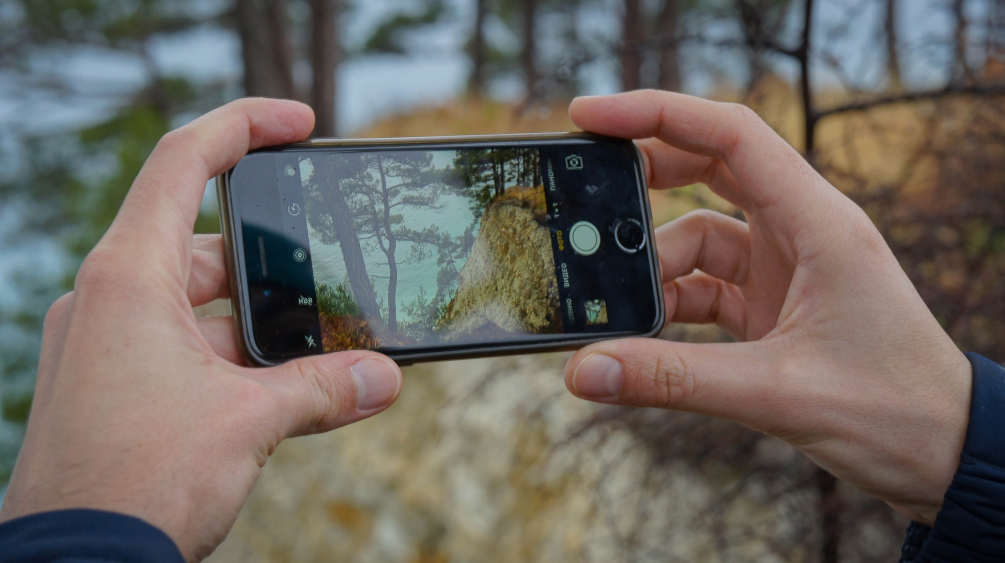
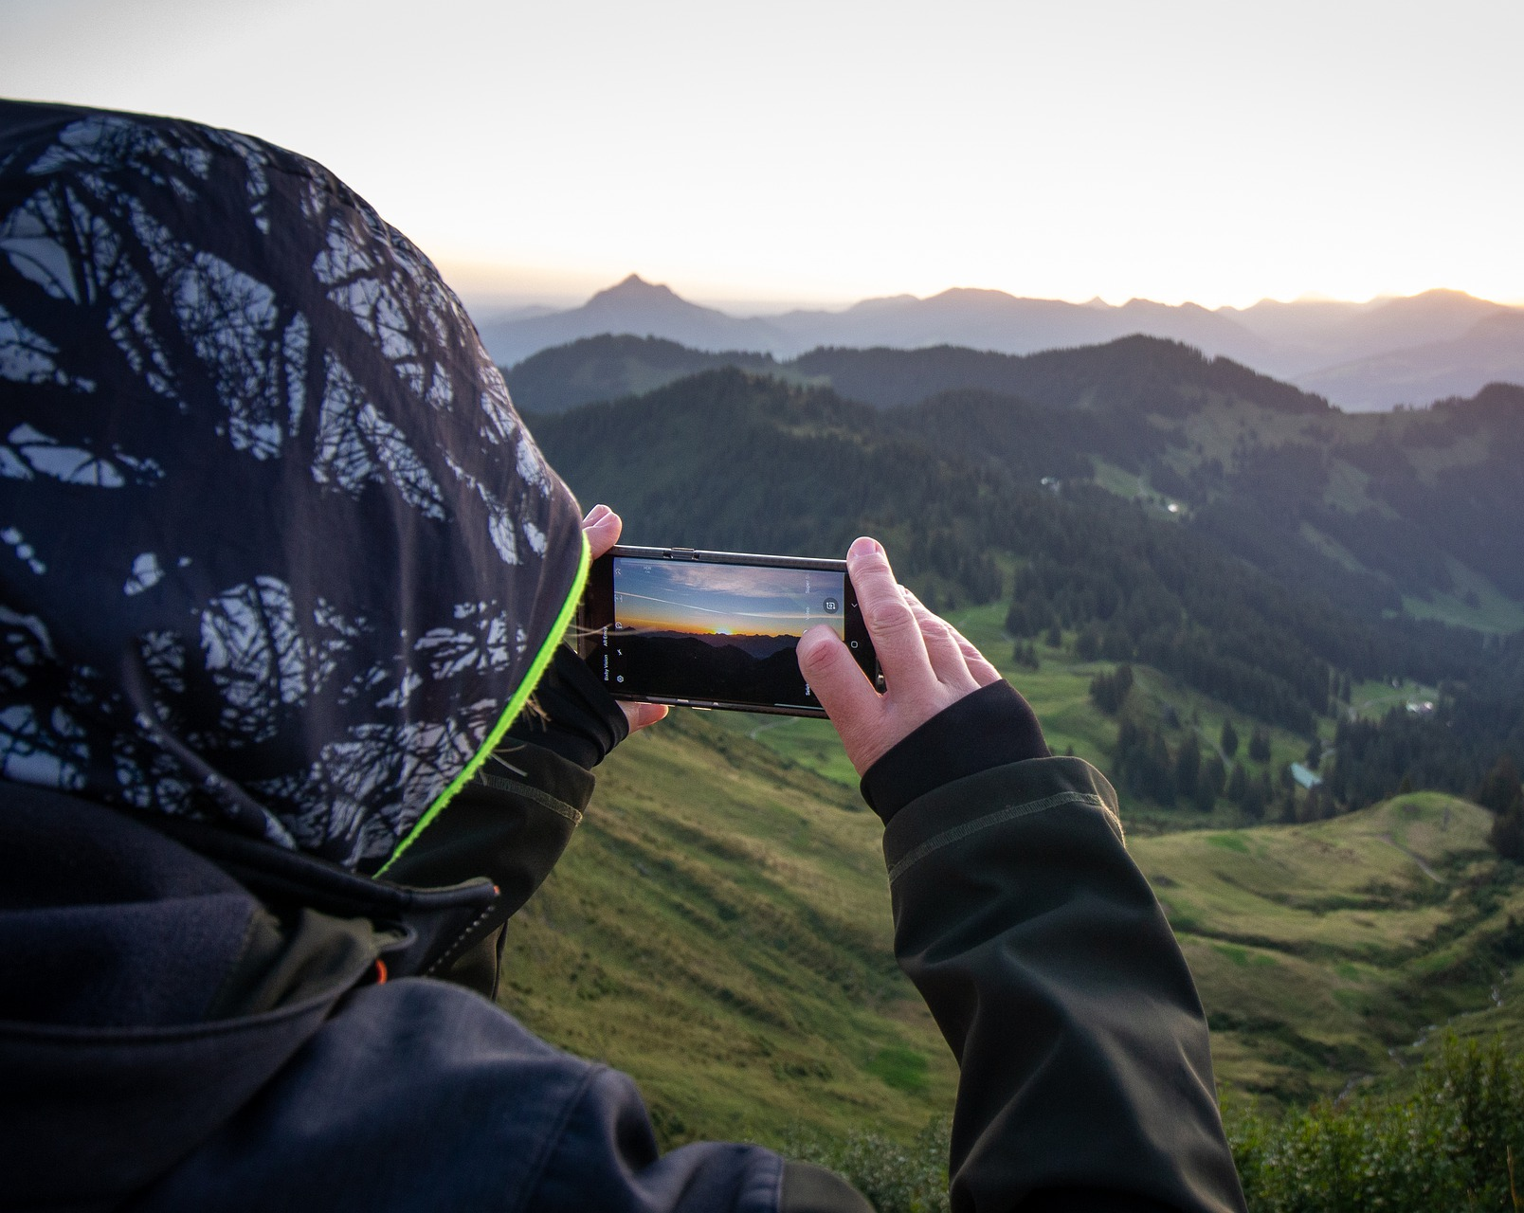
Main Focus
Photography competition - Entries can be sent to us directly through our twitter channel @monfaithfamily or sent to school and then emailed to us.
There will be a £10 voucher for the winning photograph.
Food Bank
@monfaithfamily

